Slide 1
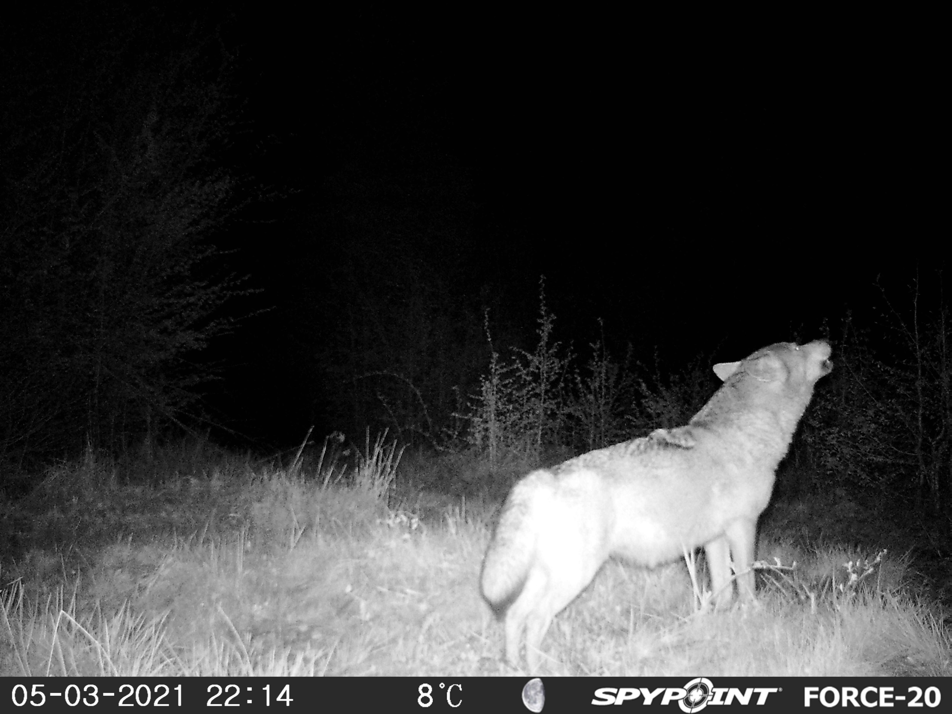
Occupancy modeling

Slide 2
Why use occupancy modeling for population dynamics?
Occupancy modeling: a tool to estimate true populations
Can use occupancy (presence/absence) data to look at population trends
The ability to estimate populations often confounded by the inability to accurately count species
  Occupancy modeling can be used to get more accurate estimates
Able to use occupancy modeling to look at species distributions
  Multiple season/year data can show how these distributions are changing over time

Slide 3
Parameters of Interest: Occupancy
The proportion of area, patches or sample units that is occupied
  ie. a species presence
Ψ (psi): probability that a randomly selected site or sampling unit in an area of interest is occupied by a species
Notes:
What really is occupancy? Whether or not a species is present or absent in a space….
where x = number of occupied sites and s = total number of sites)
BUT, because not all individuals are detected, the x value is not typically known and therefore need to estimate detection probability to estimate occupancy

Slide 4
Parameters of Interest: Detection
Detection Probability (Pj): the probability of detecting the species during the j^{th} survey, given it is present
  considered an a priori expectation that a particular site will be occupied by the species as determined by some underlying process
Proportion: realization of that process
The distinction becomes important when a large portion of the population of interest is sampled
Notes:
What process?

Slide 5
Why use occupancy?
Presence/absence data is easier to sample and collect than abundance, especially for rare species
  Requires less effort and is less expensive to collect
Can be used to study both single species and multiple species
For monitoring it can used as a metric reflecting the current state of the population

Slide 6
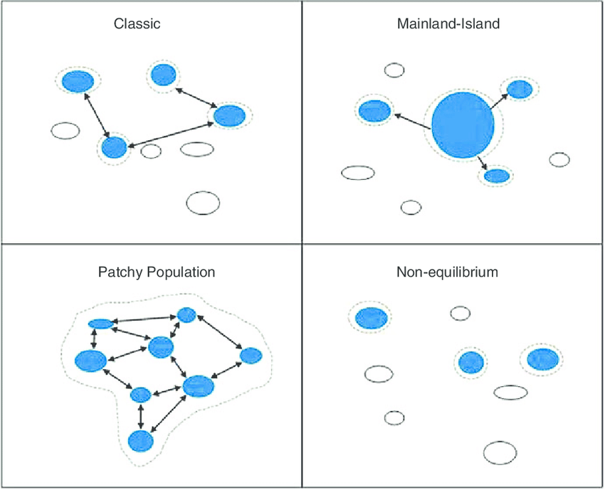
Occupancy can be used for:
Metapopulation dynamics (patch occupancy models)
Observed colonization and extinction
Distribution and range
Animal invasions
Disease dynamics
Habitat relationships
Extensive monitoring programs: 'trends' or changes in occupancy over time

Slide 7
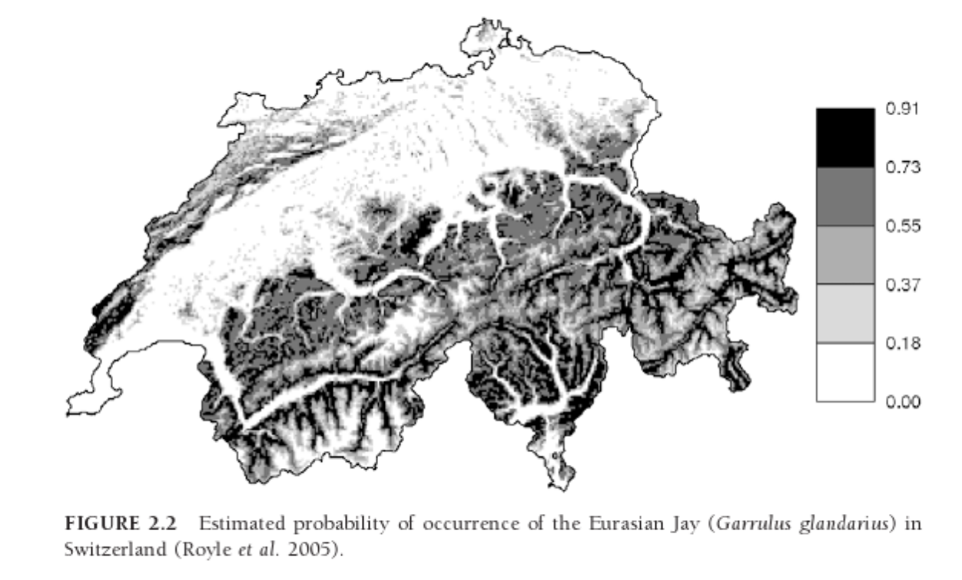
Geographic Range
Area of occurrence: the set of grid cells that contain at least one individual when a grid is superimposed on the area containing all individuals of a species (but may contain cells with no individuals)

Slide 8
Habitat Relationships
Use presence/absence data to determine habitat variables that describe sites occupied by species (or not)
Use habitat variables to which a species responds and then develop habitat models or predict abundance/occupancy
Majority of habitat studies based on occupancy have been directed at conservation and management
False-absences need to be considered

Slide 9
Occupancy data
Presence-absence data: estimation of occupancy rates and associated dynamics that are fundamental for habitat model and metapopulation studies
Whether a “patch” (or site) is occupied by one or more individuals of a population or species

Slide 10
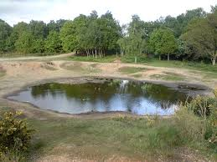
Occupancy data
Unit of interest: the extent of occurrence or area of occupancy
Example: for pond dwelling amphibians, the pond is the unit of interest

Slide 11
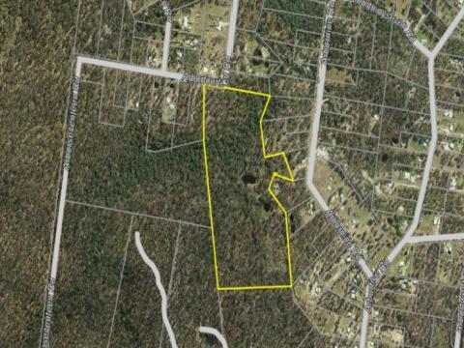
Occupancy data
Unit of interest: the extent of occurrence or area of occupancy
Example: for a terrestrial animal being studied units may be defined as 1,000 hectare blocks within a national park
Notes:
line that encloses an area containing all of the individuals of the species-this area should include all of the sites occupied by the species

Slide 12
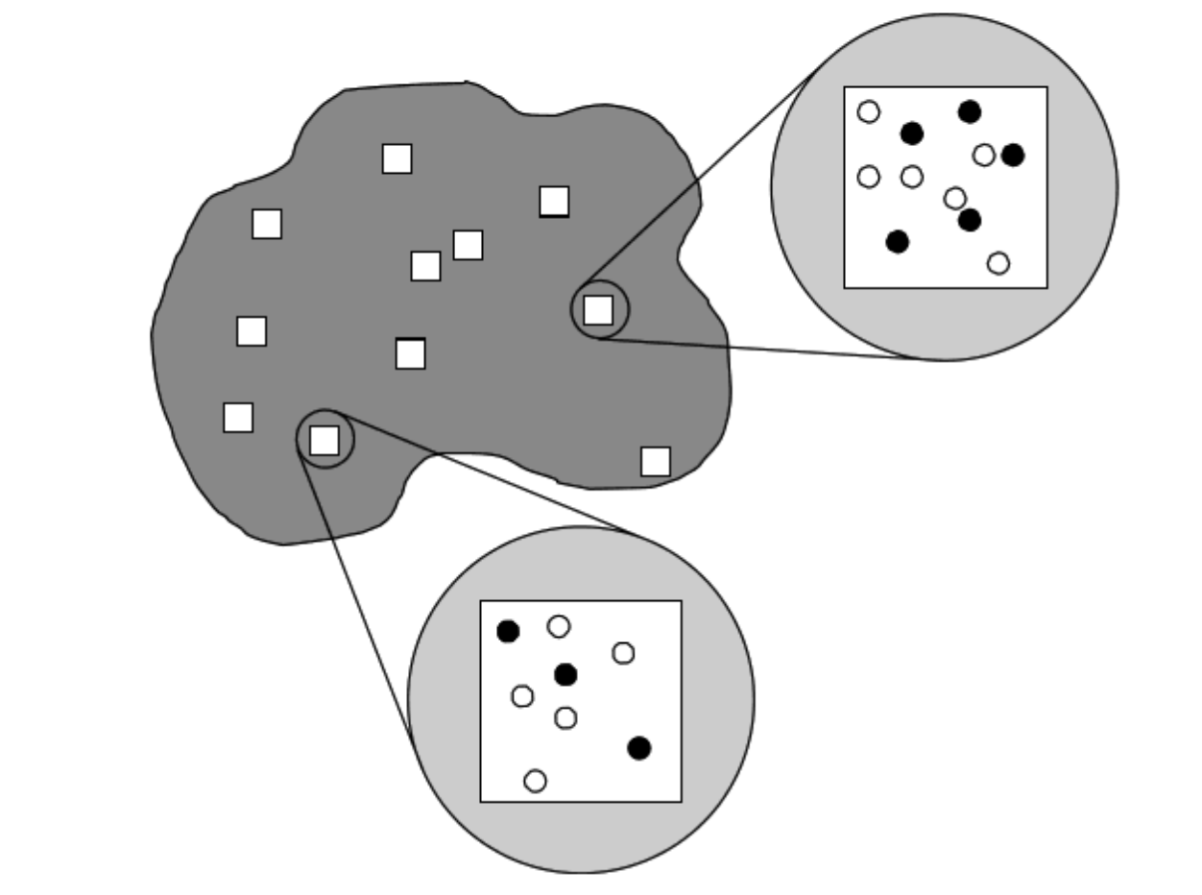
2 critical factors when sampling animal populations:
Spatial variation
  Investigators select a sample of locations to survey
Detectability
  Even in surveyed areas, animals and whole species can go undetected

Slide 13
Occupancy data: Non-detection
Non-detection does not equate to species absence
Bias: sites may be visited but no animals detected therefore producing false negatives
  “False-absence”
Failure to account for imperfect detectability will result in:
  Underestimates of site occupancy
  Biased estimates of local colonization and extinction probabilities and turnover rates
Therefore need to incorporate detection as a parameter into occupancy models

Slide 14
Occupancy Sampling Protocol
No restrictions on sampling approaches
  Can include: visual observations of animals, captures of animals in traps or mist nets, observations of animal tracks, detection of animal vocalizations, camera traps
Survey produces a list of surveyed sites that are:
  “Occupied” (species detected)
  “Unoccupied” (species not detected)
Counts of occupied sites are used to compute the proportion of occupied sites among all sites visited
  Estimate of occupancy

Slide 15
Data Collection
Data is collected by visiting a number of sites and recording whether individuals of interest are present (recorded as 1) or not present (0)
Important to repeat surveys over a short time frame (no changes in the state of a given site are allowed)
Occupancy probability: calculated as the proportion of sites that are occupied
Extinction probability: calculated as the proportion of occupied sites at time t, not occupied at time t+1.
Results can be confounded by detection error
  Recorded ‘absence’ may be a ‘non-detection’ of available individuals and not true absence

Slide 16
Data Collection: Detection Error
Detection probability (p):
  Factors other than abundance may influence detection probability
  Individual animals may be more visible or detectable in one habitat than another; weather patterns may influence detection, etc.
  Potential for misleading inference about true relationship between occupancy and habitat
If detection probability can be calculated, then unbiased estimators of occupancy, extinction and colonization can be derived

Slide 17
Data Collection: Detection Error
Detection Error Solutions:
Dealing with false-absences by visiting sites multiple times to avoid missing a species
Statistically address the issue by incorporating detection parameters into occupancy models
Best Case Scenario: incorporate BOTH collection of additional information (visiting site multiple times) into sampling protocol and utilizing models that incorporate detection probabilities

Slide 18
The Issue with Detection and Occupancy Probability
Wildlife species are rarely detected with 100% accuracy
The issue: the measure of occupancy (presence/absence at a set of sites) is confounded with the detectability of the species
Detectability (p) can vary among study sites
  Can be related to site and survey level parameters: temperature, precipitation
Due to variation in detectability presence/absence data cannot be simply analyzed
Inferences of site characteristics on occupancy will be hard to discern reliably

Slide 19
Site occupancy: A solution
MacKenzie et al. 2002 (Ecology)
Key design issues: Replication
  Temporal replication: repeat visits to sample units
    Replicate visits occur within a relatively short period of time (e.g., a breeding season)
  Spatial replication: randomly selected ‘sites’ or sample units within area of interest

Slide 20
Basic Sampling Scheme:
Single Season
s sites are surveyed, each at k distinct sampling occasions.
Species is detected/not detected at each occasion.

Slide 21
Necessary information: Detection histories
Detection history: Record for each visited site or sample unit
  1 denotes detection
  0 denotes non-detection
Example detection history: h_{i} = 1 0 0 1
  Denotes 4 visits to the site
  Target species detected during visits 1 and 4
  0 does not necessarily mean the species was absent
    Not detected, but could be there!

Slide 22
Occupancy protocol
Several sampling units surveyed

Slide 23
Occupancy protocol
1
0
Several sampling units surveyed
0
Collection of detection/non-detection
1
1
0

Slide 24
Occupancy protocol
1001
0011
Several sampling units surveyed
0000
Collection of detection/non-detection
1011
Replicate surveys in each unit
1111
0000

Slide 25
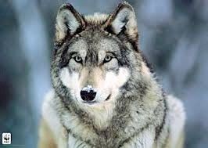
True or false absence?
1001
0011
0000
1011
1111
reality

Slide 26
True or false absence?
0011
1001
0011
1001
0000
0000
1011
1011
1111
1111
0000
reality
observation

Slide 27
True or false absence?
1001
0011
1001
0011
0000
0000
1011
1011
1111
0000
1111
reality
observation

Slide 28
True or false absence?
1001
0011
1001
0011
0000
?
1011
1011
1111
?
1111
reality
observation

Slide 29
Data structure
Sampling units = sites
We do repeated observations at each site
 | visit 1 | visit 2 | visit 3
site 1 | 1 | 0 | 1
site 2 | 0 | 1 | 1
… | … | … | …
site 3 | 0 | 0 | 0

Slide 30
Detection, detection, detection
Example detection history: h_{i} = 0 0 0 0
Is this site truly unoccupied?
It depends on the probability of detection (p)
Direct relation between detectability and number of visits
Probability of NOT seeing the species after N visits
α = (1 – p) ^ N
Minimum number of visits before concluding the site is unoccupied at a confidence level α = 0.05
Nmin = log(0.05) / log(1 – p)

Slide 31
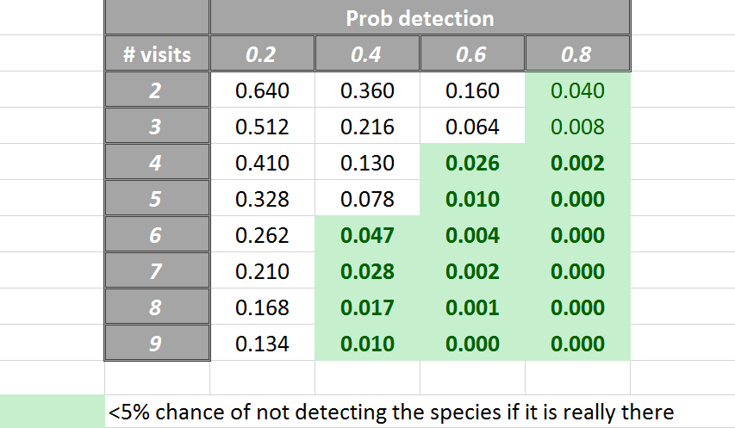
Necessary information: Detection histories
Probability of NOT seeing the species after N visits
α = (1 – p) ^ N

Slide 32
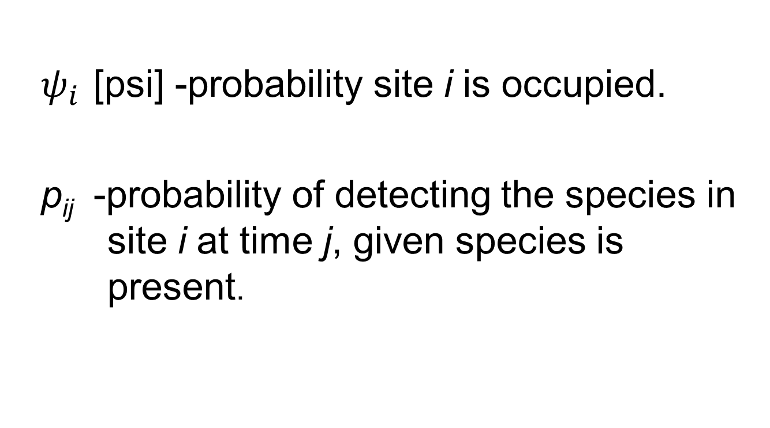
Model Parameters: Single-Season Models
$ψ_{i}$ [psi] -probability site i is occupied.
p_{ij} -probability of detecting the species in site i at time j, given species is present.

Slide 33
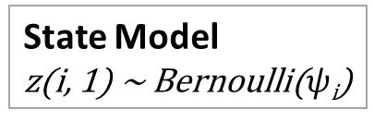
Hierarchical Statistical Model – 2 Processes
State Model
z(i, 1) ~ Bernoulli($ψ$_{i})
1001
0011
1001
0011
0000
?
1011
1011
1111
?
1111
reality
observation

Slide 34
Hierarchical Statistical Model – 2 Processes
State Model
z(i, 1) ~ Bernoulli($ψ$_{i})
Observation Model
y_{i, t} ~ Bernoulli ( z_{i} * p_{i,t} )
1001
0011
1001
0011
0000
?
1011
1011
1111
?
1111
reality
observation

Slide 35
Model assumptions
Sites are closed to changes in occupancy state between sampling occasions
No heterogeneity that cannot be explained by covariates
The detection process is independent at each site
  The farther apart, the better, but needs to be tailored to species ecology

Slide 36
Timing of repeated surveys
Usually conducted as multiple discrete visits (e.g., on different days)
Can also use multiple surveys within a single visit
  Multiple independent observers
  Potentially introduce heterogeneity into data
    Single visit to each site vs. multiple visits to each site
  Rotate observers amongst sites on each day
  order each site is sampled within a day

Slide 37
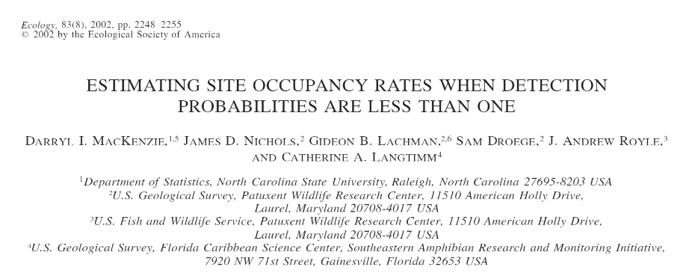
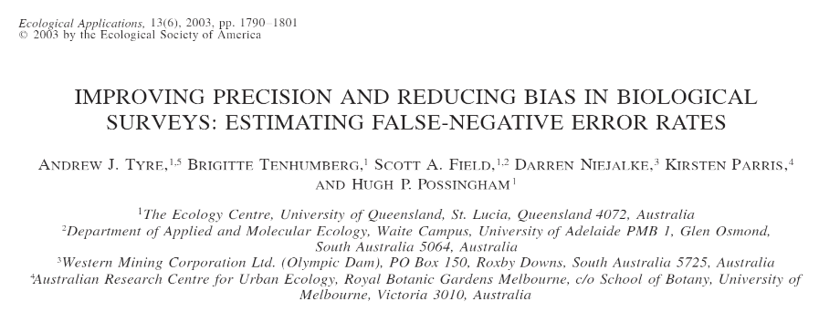

Slide 38
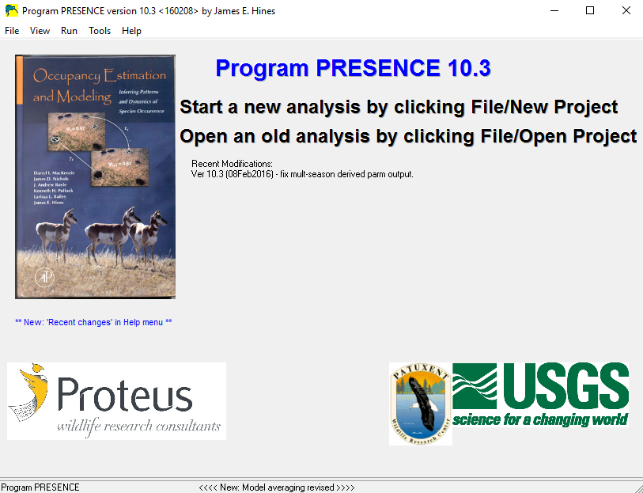
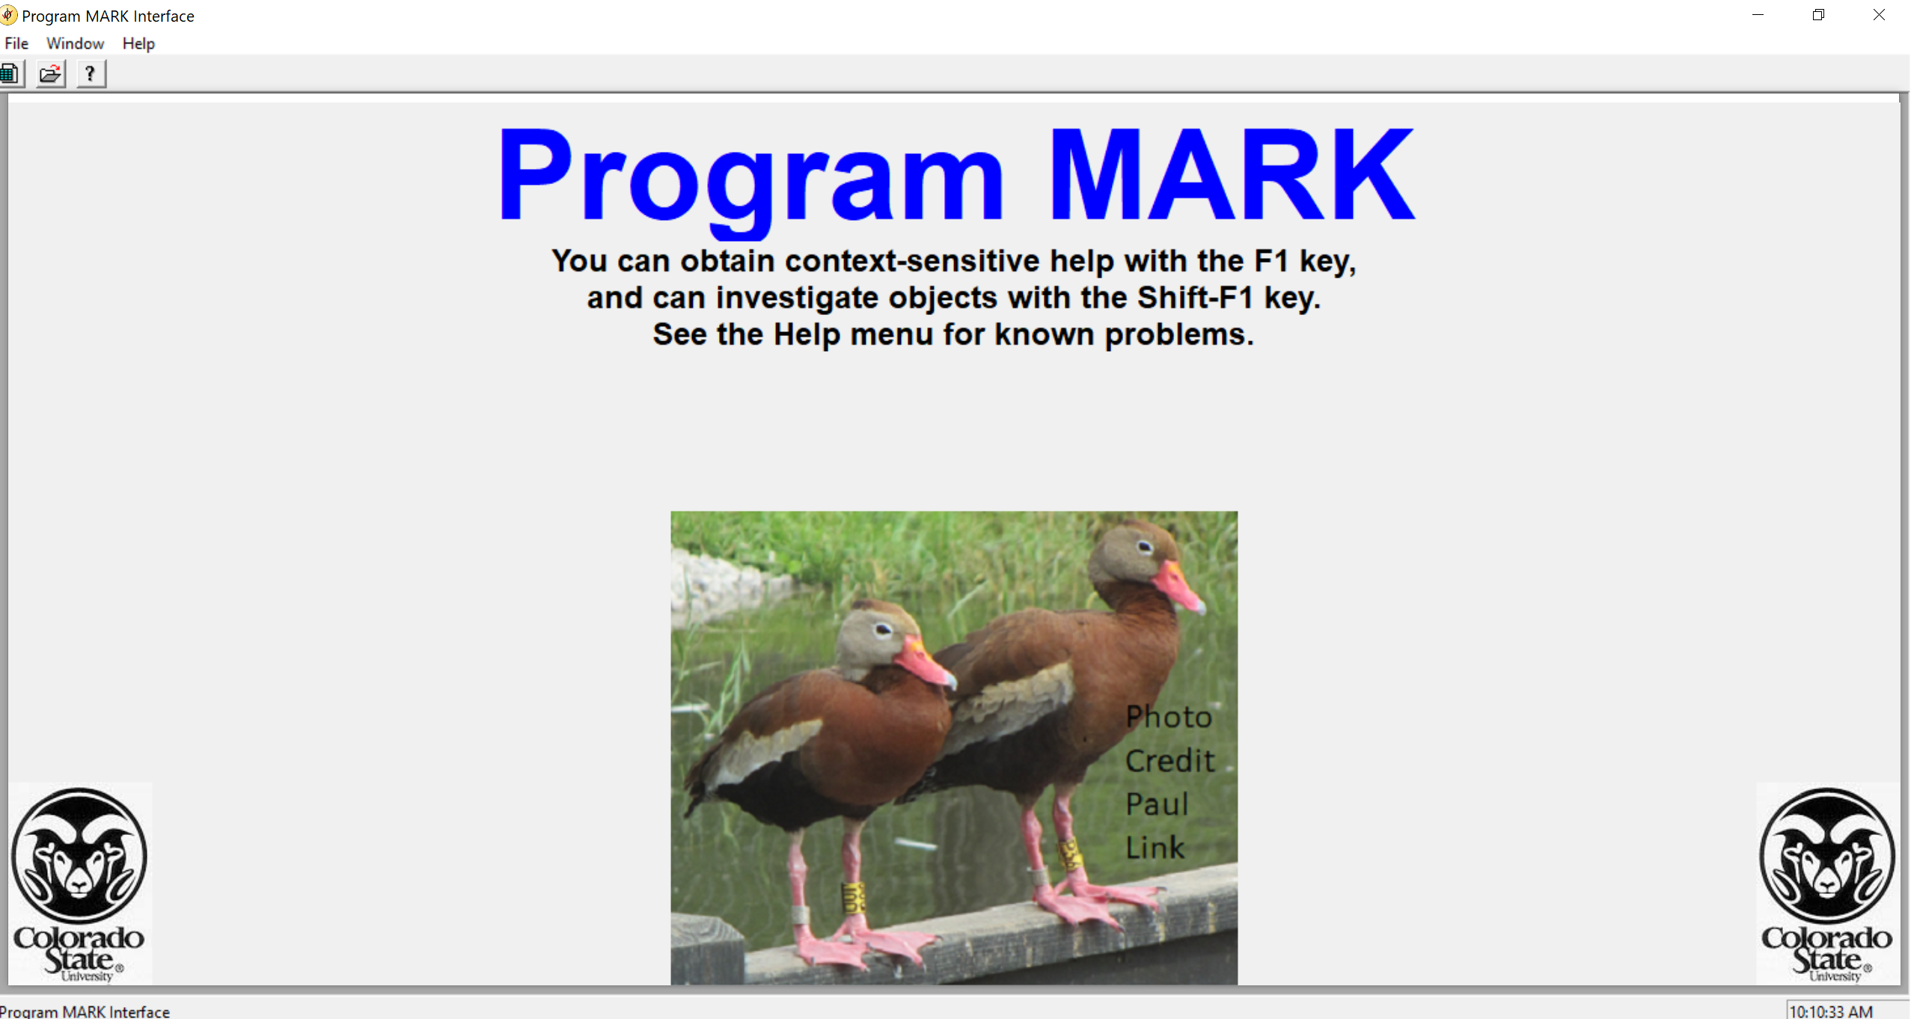
Complex occupancy models
implemented in programs PRESENCE and MARK
R packages: unmarked
spOccupancy (spatial occupancy models)
NIMBLE (Bayesian platform for model fitting)
ubms (includes random effects; Bayesian)
Notes:
38
Important tools for estimating N for mobile speices…. 1. Research CAPTURES, MARKS, and RELEASES as many individuals as possilbe, # Marked = M
2. Allows enough time for the marked individuals to mix intot the whole populaiton, then
3. Resampled the poupplation recording how many individuals are sampled (s) and how many of them possed the mark from the 1st visit and are therefore recaptured (r)

